Slide 1

Mathematics for Programming

Slide 2
Recap
Unitary method and percentage
Solving problems
Interest rate and related problems
Mean and Median

Slide 3
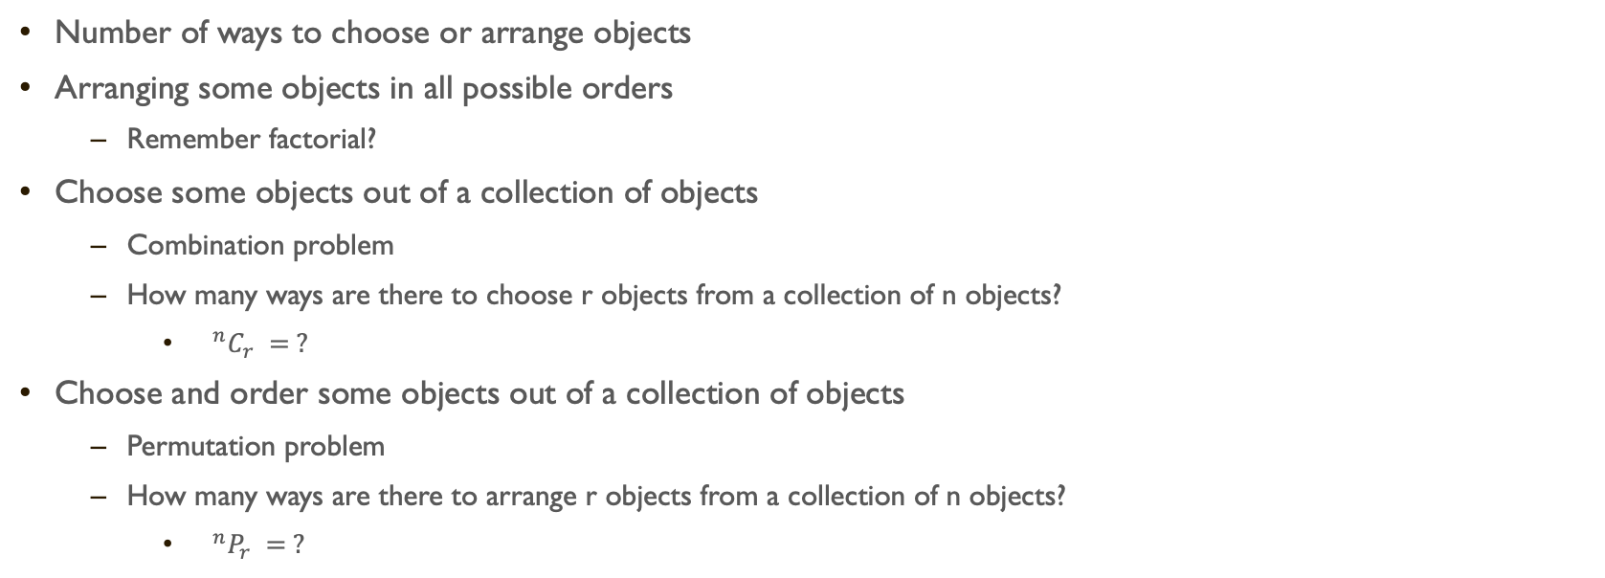
Combinatorics
Number of ways to choose or arrange objects
Arranging some objects in all possible orders
Remember factorial?
Choose some objects out of a collection of objects
Combination problem
How many ways are there to choose r objects from a collection of n objects?
${ ^{n}C}_{r} = ?$
Choose and order some objects out of a collection of objects
Permutation problem
How many ways are there to arrange r objects from a collection of n objects?
${ ^{n}P}_{r} = ?$

Slide 4
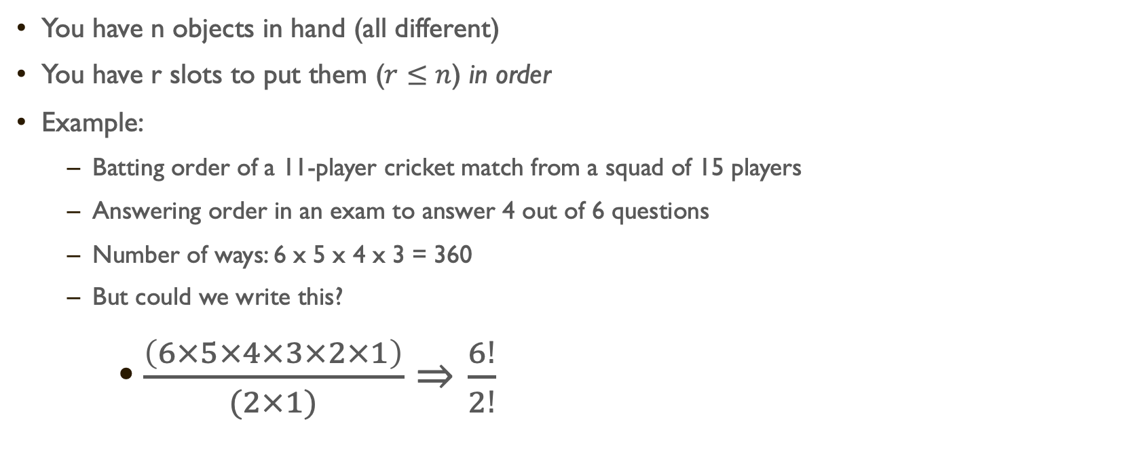

$${ ^{n}P}_{r}$$
You have n objects in hand (all different)
You have r slots to put them ($r≤n$) in order
Example:
Batting order of a 11-player cricket match from a squad of 15 players
Answering order in an exam to answer 4 out of 6 questions
Number of ways: 6 x 5 x 4 x 3 = 360
But could we write this?
$\frac{\left(6×5×4×3×2×1\right)}{(2×1)}⇒\frac{6!}{2!}$
6 | 5 | 4 | 3

Slide 5
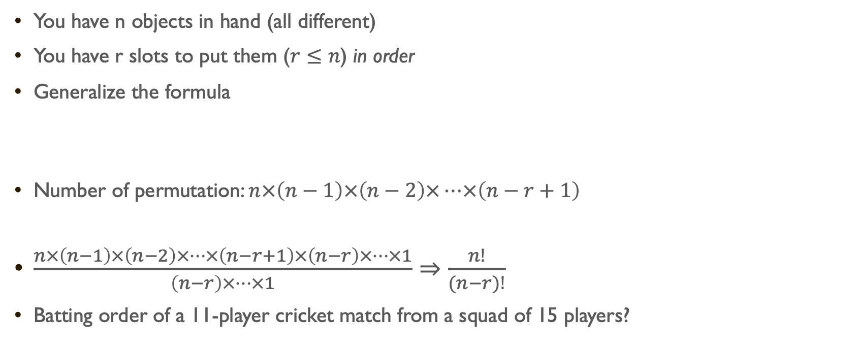
$${ ^{n}P}_{r}$$
You have n objects in hand (all different)
You have r slots to put them ($r≤n$) in order
Generalize the formula
Number of permutation: $n×\left(n−1\right)×\left(n−2\right)×…×\left(n−r+1\right)$
$\frac{n×\left(n−1\right)×\left(n−2\right)×…×\left(n−r+1\right)×\left(n−r\right)×…×1}{\left(n−r\right)×…×1}⇒\frac{n!}{(n−r)!}$
Batting order of a 11-player cricket match from a squad of 15 players?
1 | 2 | … | r
n | n-1 | … | n-r+1

Slide 6
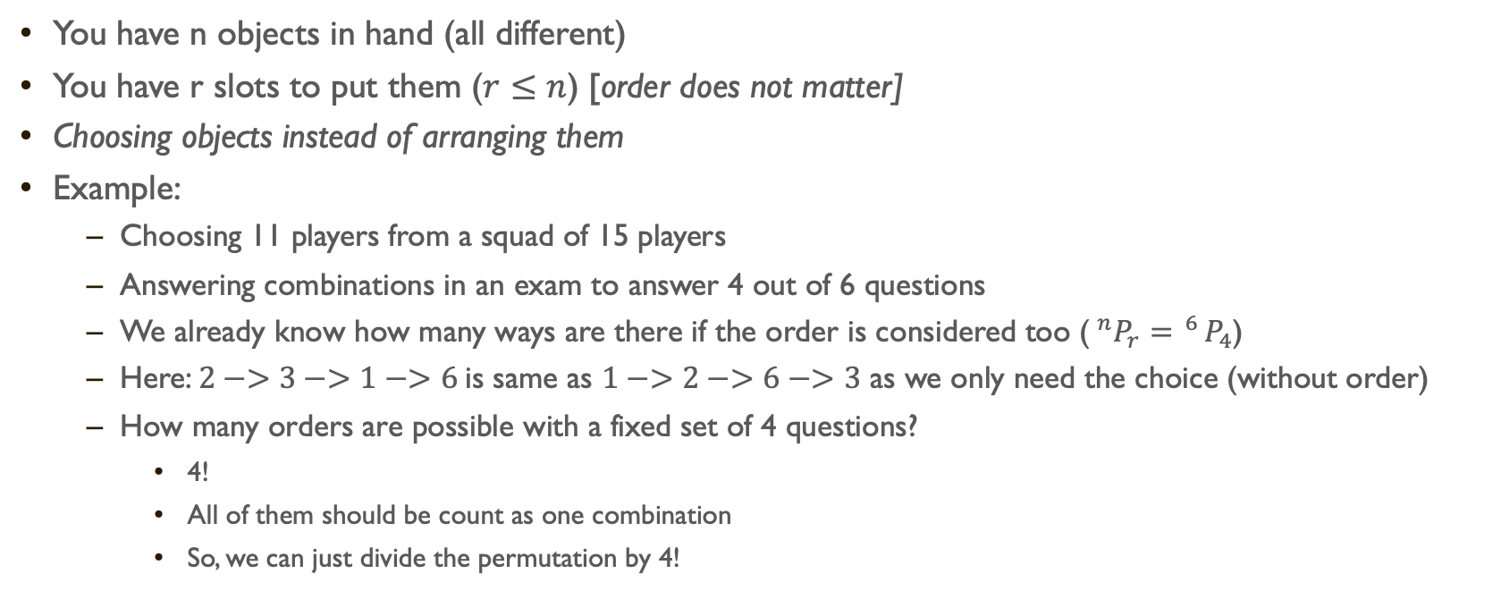

$${ ^{n}C}_{r}$$
You have n objects in hand (all different)
You have r slots to put them ($r≤n$) [order does not matter]
Choosing objects instead of arranging them
Example:
Choosing 11 players from a squad of 15 players
Answering combinations in an exam to answer 4 out of 6 questions
We already know how many ways are there if the order is considered too ($^{n}P_{r}= ^{6}P_{4}$)
Here: $2−>3−>1−>6$is same as $1−>2−>6−>3$ as we only need the choice (without order)
How many orders are possible with a fixed set of 4 questions?
4!
All of them should be count as one combination
So, we can just divide the permutation by 4!

Slide 7
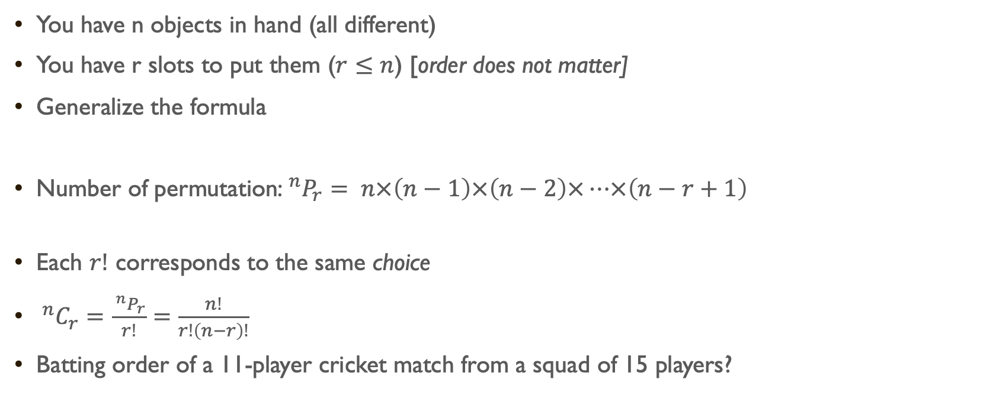
$${ ^{n}C}_{r}$$
You have n objects in hand (all different)
You have r slots to put them ($r≤n$) [order does not matter]
Generalize the formula
Number of permutation:$^{n}P_{r}= n×\left(n−1\right)×\left(n−2\right)×…×\left(n−r+1\right)$
Each $r!$ corresponds to the same choice
$^{n}C_{r}=\frac{ ^{n}P_{r}}{r!}=\frac{n!}{r!\left(n−r\right)!}$
Batting order of a 11-player cricket match from a squad of 15 players?
1 | 2 | … | r
n | n-1 | … | n-r+1

Slide 8
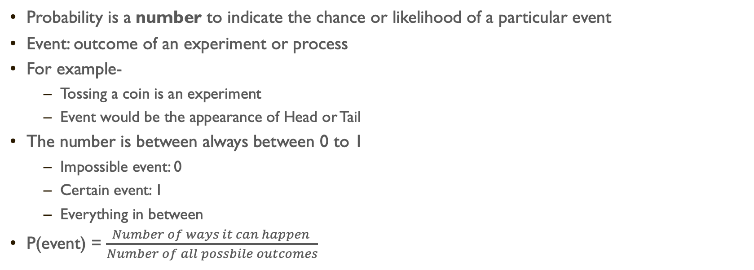
Probability
Probability is a number to indicate the chance or likelihood of a particular event
Event: outcome of an experiment or process
For example-
Tossing a coin is an experiment
Event would be the appearance of Head or Tail
The number is between always between 0 to 1
Impossible event: 0
Certain event: 1
Everything in between
P(event) = $\frac{Number of ways it can happen }{Number of all possbile outcomes}$

Slide 9
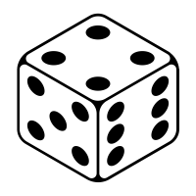
Probability
What is the probability of getting a prime number if you throw a 6-faced dice?
All possible outcomes: 1,2,3,4,5,6
Target outcomes / prime numbers: 2, 3, 5
P = 3/6 = 0.5

Slide 10
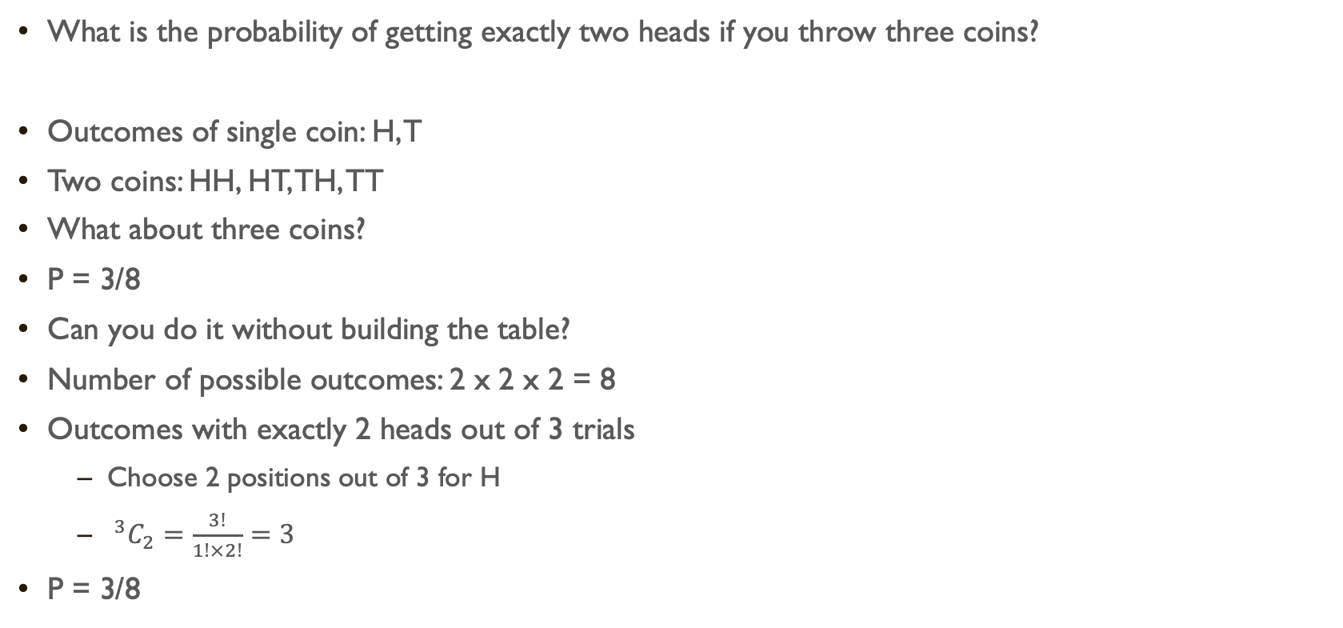
Probability
What is the probability of getting exactly two heads if you throw three coins?
Outcomes of single coin: H, T
Two coins: HH, HT, TH, TT
What about three coins?
P = 3/8
Can you do it without building the table?
Number of possible outcomes: 2 x 2 x 2 = 8
Outcomes with exactly 2 heads out of 3 trials
Choose 2 positions out of 3 for H
${ ^{3}C}_{2}=\frac{3!}{1!×2!}=3$
P = 3/8
 | HH | HT | TH | TT
H | HHH | HHT | HTH | HTT
T | THH | THT | TTH | TTT
 | H | T
H | HH | HT
T | TH | TT

Slide 11

Binary <-> OCTAL
Remember binary to decimal?
Easier than that
8 and 16 are powers of 2, 10 is not!
$8 = 2^{3} and 16 = 2^{4}$
000 to 111 => 0 to 7 (Octal)
0000 to 1111 => 0 to F (Hexadecimal)
Binary 10111011 to octal?
010 111 011 => 273
Octal 314 to binary?
314 => 011 001 100

Slide 12
Summary
Combinatorial problems
Choice / Combination / nCr
Arrangement / Permutation / nPr
Probability
Number system revisited

Slide 13
Practice day
Convert this binary number to hexadecimal number
01110100111011
Convert this octal number to hexadecimal number
127416
If you throw a dice and toss a coin at the same time, what is the probability that you will get Head (coin) and value less than 3 (dice)?
10 people came to party. Everyone shook hands with everyone. How many handshakes took place?
Section A and B have 25 students and 20 students, respectively. If a team of 11 players need to be formed and 6 students must be from A and the others from B, how many ways are there to form the team? How many batting order would be there?

